Slide 1

Course Title: Peripherals and Interfacing
Course Code : CSE333
Thanjida Akhter : 102-15-1030

Slide 2








YEAR 1968........

Slide 3






Slide 4
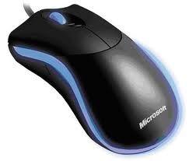
Mouse
Mouse a peripheral device.
The main goal is to translate the motion of our hand into signals which computer can use.

Slide 5
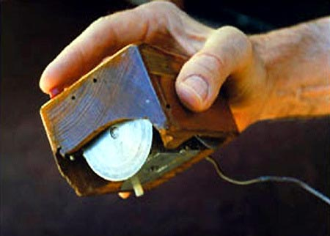
History Of Mice Part-1
The mouse didn’t always look the way it does. When the creator of a mouse, Douglas Engelbart, first made the mouse in 1964 (first prototype), it was a piece of wood with metal wheels inside of it.

Slide 6
History Of Mice Part-2
Six years after Engelbart made the mouse they gave it the name of “Mouse” because it had the tail that came out of it to connect to the computer.

Slide 7

History Of Mice Part-3
In 1968 Engelbart held a presentation to show he had made the mouse, what it was used for, and why people should use this.
Because of this presentation he won an award for a great technology achievement, and he won $500,000.
Later he was put into the hall of fame for inventors.

Slide 8
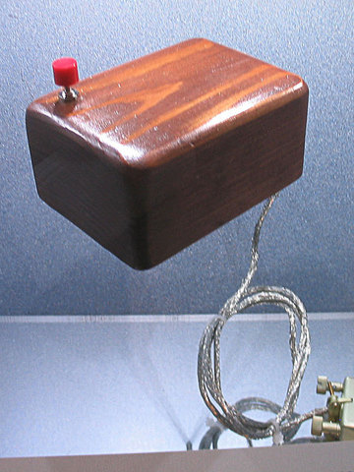
History Of Mice Part-4
After Englebarts attempt to make a mouse a technician, Bill English, created his own mouse. But this mouse he made was not the same kind of mouse Englebarts created, his was a ball mouse, not a wheel mouse.
After completing his creation his mouse became the most successful, and most used mouse.

Slide 9
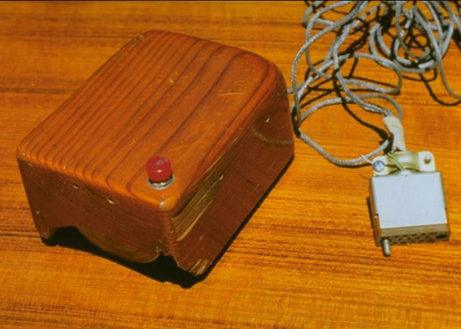
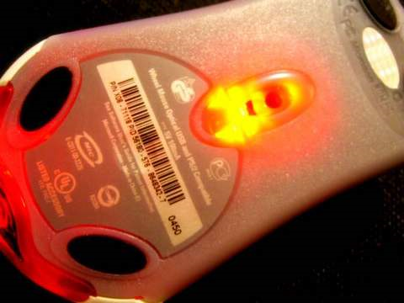

History Of Mice Part-5(Final)
After Bill’s mouse the next kind of mouse that came out was a mouse that moves from the laser moving to certain new spots, sound familiar?
After Bills Prototype mouse it then went to our kinds!

Slide 10
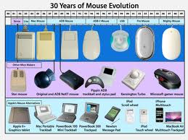

Slide 11
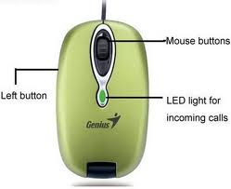
Mouse Terms and Techniques
Point
Click
Double Click
Right Click
Scroll
Drag
Drop
Highlight

Slide 12

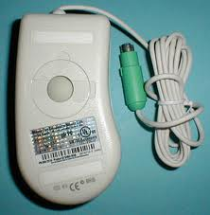
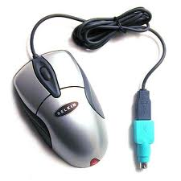
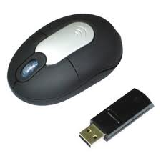
Type of Mouse
Ball Mice
Optical Mice
Laser Mice
Wireless Mice
Wireless Laser Mice

Slide 13

Mouse Manufacturer's
Microsoft
Logitech
Razer
Ideazon
Evoluent

Slide 14
How to use a corded mouse
If mouse is corded, connect mouse to the back of the computer in the mouse slot.
Put hand on the mouse.
Move hand to go in the wanted direction.
Click left button to go to an address bar, link, or anything one can go to.
Click right finger to open up a options menu.
One use the scroll wheel is to move screen up or down when in a screen.

Slide 15
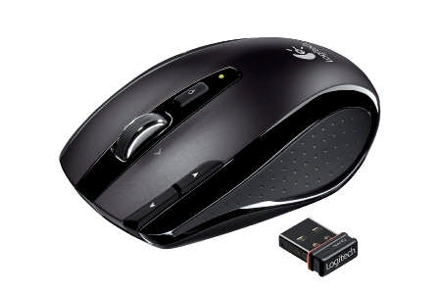
How to use a wireless mouse
Either put a USB in the computer and the mouse will automatically show up on the computer. Or…
Connect the wireless mouse adaptor
Press the connect button on the mouse, and the wireless adaptor.
Wait a few seconds
Mouse is connected!

Slide 16
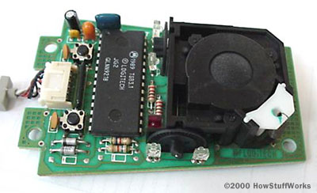
How the mouse works
The reason the mouse is so accurate is because whenever you click or move your mouse, a signal is sent to the computer and the computer reads what the mouse is moving to or what it clicked on, then it reacts.
Almost all mice today do the translation using five components:

Slide 17
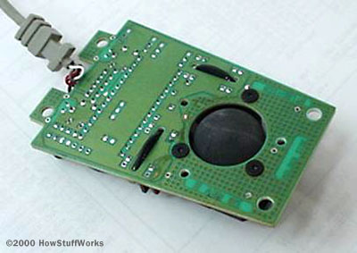
Component Number 1 :
A ball inside the mouse touches the desktop and rolls when the mouse moves.
The underside of the mouse's logic board: The exposed portion of the ball touches the desktop.

Slide 18
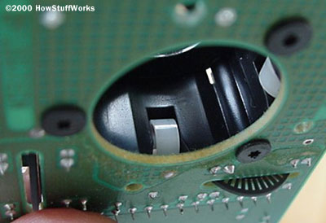
Component Number 2 :
Two rollers inside the mouse touch the ball. One of the rollers is oriented so that it detects motion in the X direction, and the other is oriented 90 degrees to the first roller so it detects motion in the Y direction. When the ball rotates, one or both of these rollers rotate as well. The following image shows the two white rollers on this mouse:

Slide 19
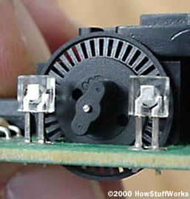
Component Number 3 :
The rollers each connect to a shaft, and the shaft spins a disk with holes in it. When a roller rolls, its shaft and disk spin. The following image shows the disk:
Typical optical encoding disk has 36 holes around its outer edge.

Slide 20
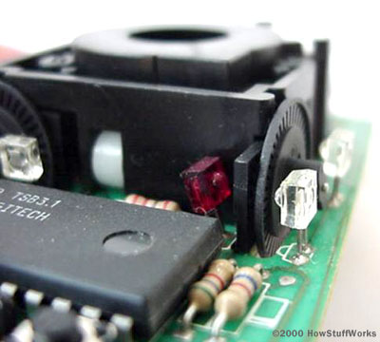
Component Number 4 :
On either side of the disk there is an infrared LED and an infrared sensor. The holes in the disk break the beam of light coming from the LED so that the infrared sensor sees pulses of light. The rate of the pulsing is directly related to the speed of the mouse and the distance it travels.
In Figure:
Red (Sensor)
Clear (LED)

Slide 21
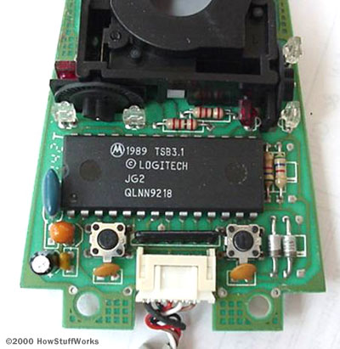
Component Number 5 :
An on-board processor chip reads the pulses from the infrared sensors and turns them into binary data that the computer can understand. The chip sends the binary data to the computer through the mouse's cord.
connector ).

Slide 22
How components works :
In this optomechanical arrangement, the disk move mechanically and an optical system counts pulses of light.
Each encoder disk has two infrared LEDs and two infrared sensors, one on each side of the disk . This arrangement allows the processor to detect the disk's direction of rotation.
A close-up of one of the optical encoders that track mouse motion: Note the piece of plastic between the infrared sensor (red) and the encoding disk.

Slide 23
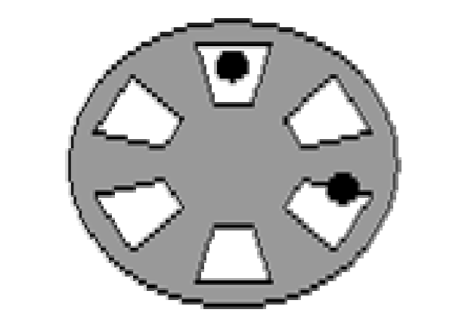
Direction
Inside the mouse there are two wheels. The wheel is usually made of black plastic with rectangular slots punched in it. The figure shows only 6 slots at 60° spacing but they are a lot closer and many more. Shining through the slots are two LEDs (light Emitting Diodes) shown by the black dots. Each LED shines on to a light sensor. The two LEDs are spaced so that, when one sensor can 'see' its LED through the centre of its window, the other LED is looking at an edge and is therefore switching on or off. In the diagram LED A is fully illuminated and LED B is switching. Here LED B may be switching from light to dark or from dark to light - this depends on the rotation direction.

Slide 24
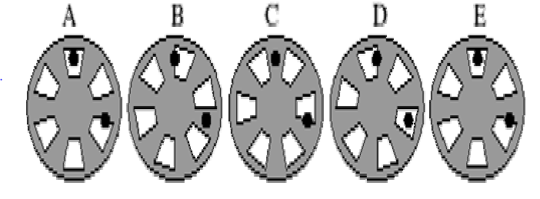
Direction(Cont….)
Now consider the second drawing. Here the wheel is shown in 4 different states, each 15° rotated from the last. Diagram E is equivalent to diagram A, being 60° rotated. For clockwise rotation the states follow each other in order A-B-C-D-E from left to right but if you read the states from right to left, E-D-C-B-A, then these correspond to anticlockwise rotation.

Slide 25
Direction(Cont….)
Notice that LED 2 is changing state from light to dark in diagram A for clockwise rotation and in diagram C for anticlockwise rotation. So if we measure LED1 everytime LED 2 goes from light to dark, if LED 1 is light then we are rotating clockwise but if LED 1 is dark, then we have anticlockwise rotation. The computer uses this fact to monitor direction: each time LED 2 goes from light to dark it samples LED 1 to determine the direction. It uses the number of transitions to measure the distance.

Slide 26
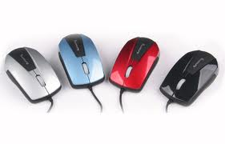
The Optical Mouse
The optical mouse actually uses a tiny camera to take thousands of pictures every second.
Able to work on almost any surface without a mouse pad.
Most optical mice use a small, red (LED) that bounces light off that surface onto a (CMOS) sensor. In addition to LEDs, a recent innovation are laser-based optical mice that detect more surface details compared to LED technology.

Slide 27
The Optical Mouse
Here's how the sensor and other parts of an optical mouse work together:
The CMOS sensor sends each image to a digital signal processor (DSP) for analysis.
The DSP detects patterns in the images and examines how the patterns have moved since the previous image.
Based on the change in patterns over a sequence of images, the DSP determines how far the mouse has moved and sends the corresponding coordinates to the computer.
The computer moves the cursor on the screen based on the coordinates received from the mouse. This happens hundreds of times each second, making the cursor appear to move very smoothly.

Slide 28
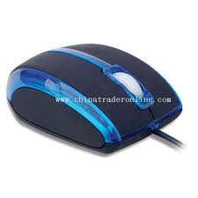
The Optical Mouse
Optical mice have several benefits over track-ball mice:
No moving parts means less wear and a lower chance of failure.
There's no way for dirt to get inside the mouse and interfere with the tracking sensors.
Increased tracking resolution means a smoother response.
They don't require a special surface, such as a mouse pad..
.

Slide 29
Wireless Mouse
Most wireless mice use radio frequency (RF) technology to communicate information to your computer.
RF devices require two main components:
a Transmitter and a Receiver.
The transmitter is housed in the mouse. It sends an electromagnetic (radio) signal that encodes the information about the mouse's movements and the buttons you click.
The receiver, which is connected to computer, accepts the signal, decodes it and passes it on to the computer's operating system.
The receiver can be a separate device that plugs into computer, a special card that you place in an expansions lot, or a built-in component.

Slide 30
Benefits of Wireless Mouse
Unlike infrared technology, which is commonly used for short-range wireless communications such as television remote controls, RF devices do not need a clear line of sight between the transmitter (mouse) and receiver. Just like other types of devices that use radio waves to communicate, a wireless mouse signal can pass through barriers such as a desk or your monitor.
RF technology provides a number of additional benefits for wireless mice. These include:
RF transmitters require low power and can run on batteries
RF components are inexpensive
RF components are light weight

Slide 31
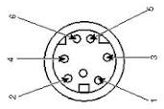
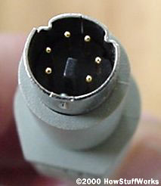
Data Interface
Most mice in use today use the standard PS/2 type connector, as shown here:
These pins have the following functions (refer to the above photo for pin numbering):
Unused
+5 volts (to power the chip and LEDs)
Unused
Clock
Ground
Data

Slide 32

What Data is Sent
Whenever the mouse moves or the user clicks a button, the mouse sends 3 bytes of data to the computer. The first byte's 8 bits contain:
Left button state (0 = off, 1 = on)
Right button state (0 = off, 1 = on)
0
1
X direction (positive or negative)
Y direction
X overflow (the mouse moved more than 255 pulses in 1/40th of a second)
Y overflow
The next 2 bytes contain the X and Y movement values, respectively. These 2 bytes contain the number of pulses that have been detected in the X and Y direction since the last packet was sent.

Slide 33
The data is sent from the mouse to the computer serially on the data line, with the clock line pulsing to tell the computer where each bit starts and stops. Eleven bits are sent for each byte (1 start bit, 8 data bits, 1 parity bit and 1 stop bit). The PS/2 mouse sends on the order of 1,200 bits per second. That allows it to report mouse position to the computer at a maximum rate of about 40 reports per second. If you are moving the mouse very rapidly, the mouse may travel an inch or more in one-fortieth of a second. This is why there is a byte allocated for X and Y motion in the data protocol.
Some mice use serial or USB type connectors.

Slide 34
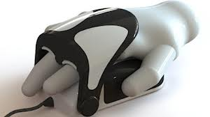

Thank You.
END.

